Slide 1

Rsync增量传输场景

Slide 2
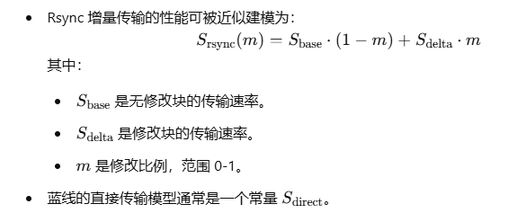
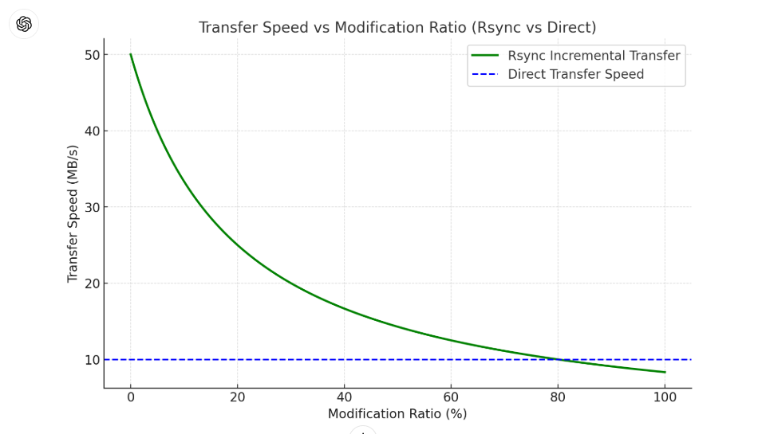
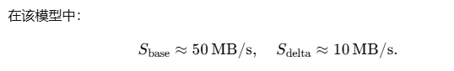

Slide 3

核心问题
delta (encoding)change algorithm
rolling checksum algorithm
The rsync algorithm
1. quick check (size, always checksum, mtime)
2. rolling checksum in send_files()
3. 3-level search in send_files()
Server, Client and Daemon → sender & receiver & generator
send_files()/recv_files()/generate_files()

Slide 5
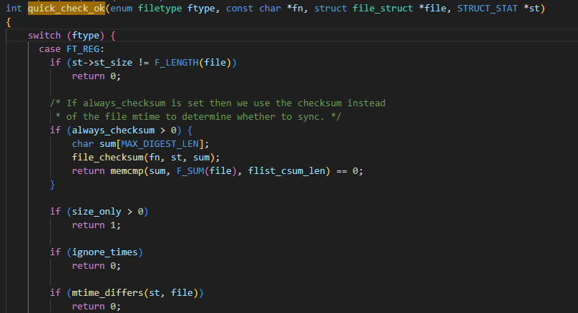
1. quick_check_ok()
File Size: If the sizes of the source and destination files differ, the file is marked for synchronization.
Always checksum: Optionally, a full checksum of the file can be calculated for validation.
Modification time (mtime): If the last modification times of the files differ, rsync flags the file for further checks or synchronization.

Slide 6
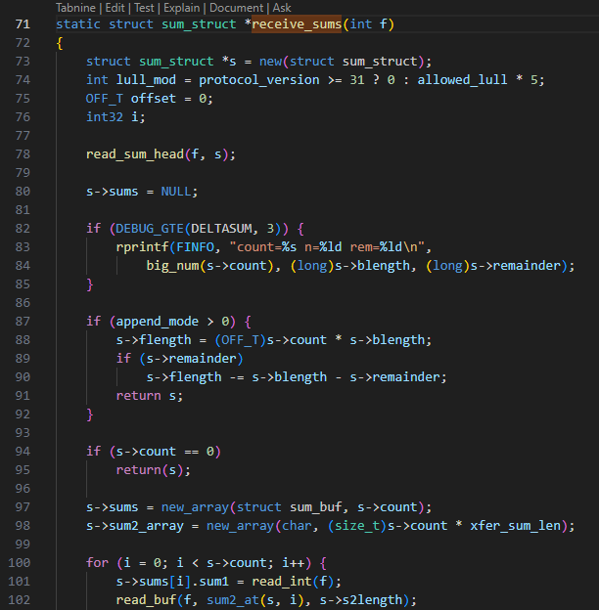
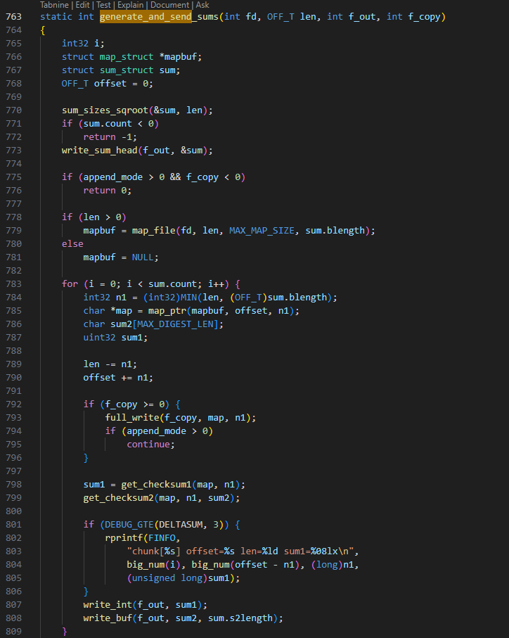
sum functions
receive_sums(): called in send_files() to receive checksums from receiver
match_sums(): called in send_files() to match checksums from receiver
generate_and_send_sums(): called in generate_files() in receiver’s side
sum_update()
get_checksum1()
get_checksum2()
sum_end()
sum_init()
…

Slide 7
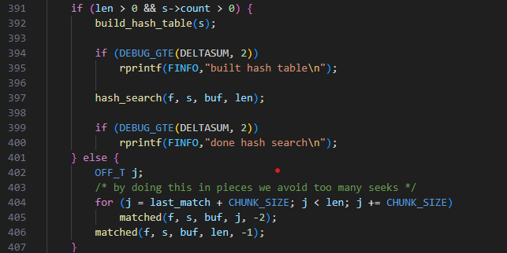
2. match_sums()
Files are divided into fixed-size blocks
A rolling checksum is calculated for each block in the source file. This checksum allows quick recalculations when the comparison window moves by one byte, using a formula that updates the checksum incrementally rather than recomputing it from scratch.
The destination file's blocks have both a rolling (weak) checksum and a strong checksum (e.g., MD5) stored. The weak checksum quickly identifies potential matches, and the strong checksum confirms these matches.

Slide 8
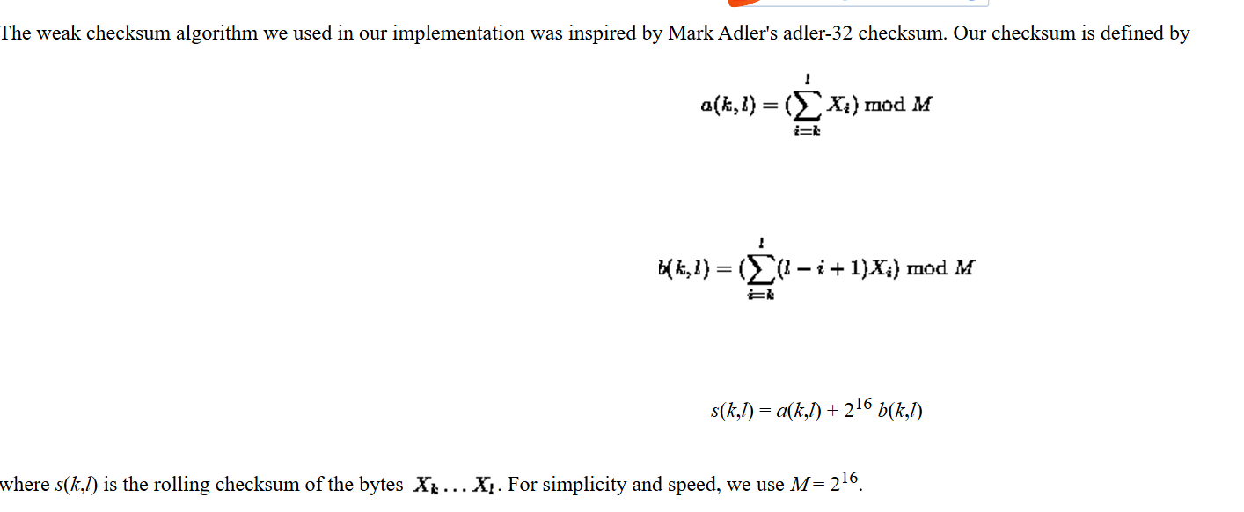
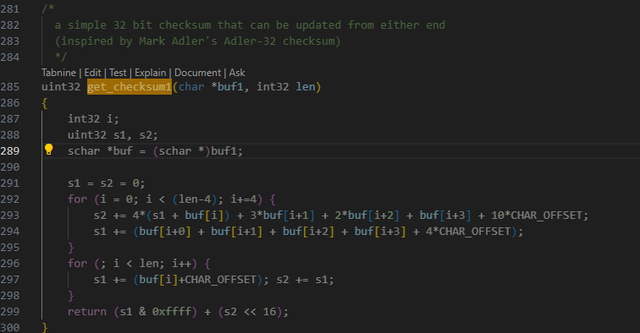
get_checksum1()/get_checksum2()

Slide 9
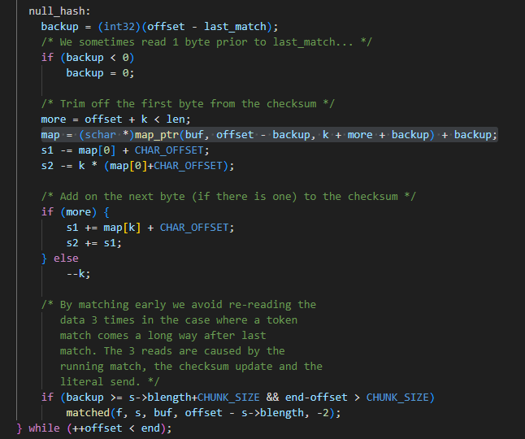
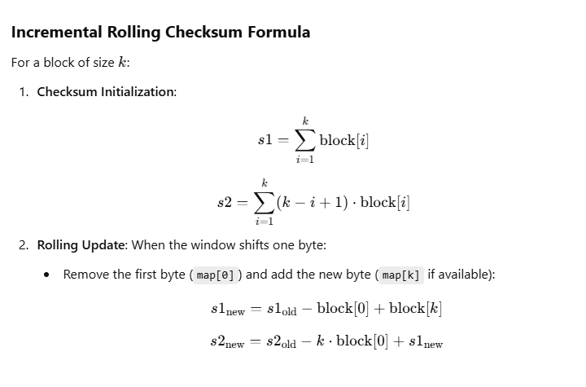
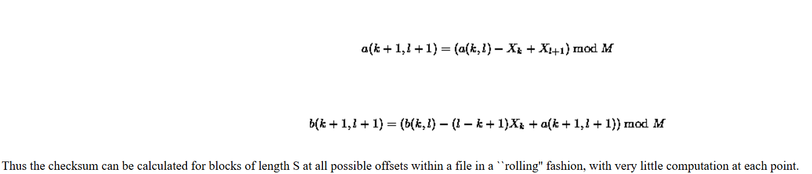
Hash check not hitted

Slide 10
3. hash_search()
Level 1: 16-bit hash table:
A hash of the rolling checksum is calculated and used to index a hash table of block checksums.
The hash table reduces the number of blocks to consider.
Level 2: Weak checksum comparison:
If the hash table indicates a match, the weak checksum of the current source block is compared to the destination’s checksum.
Level 3: Strong checksum validation:
For potential matches, the strong checksum (e.g., MD5) confirms the block match with near certainty.

Slide 11
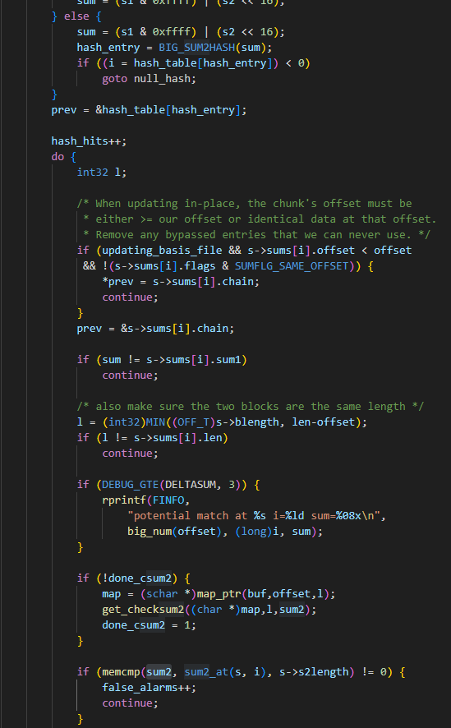

Slide 12
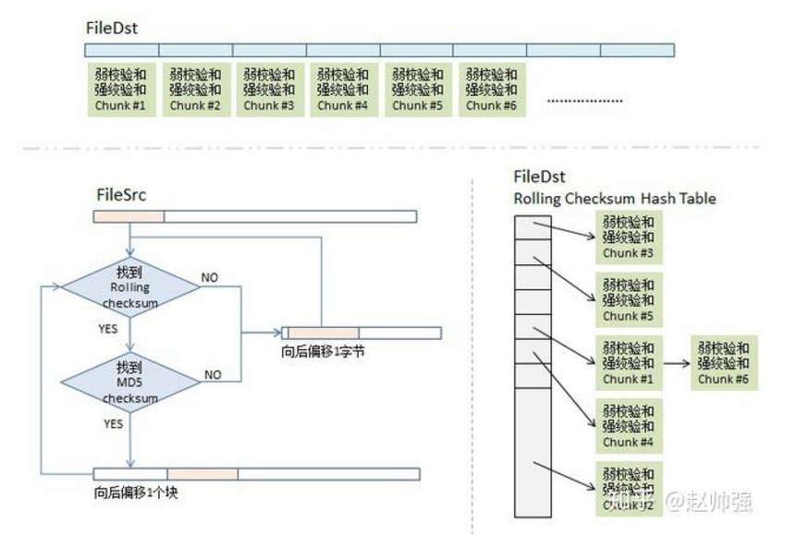
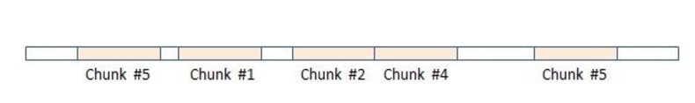

Slide 13
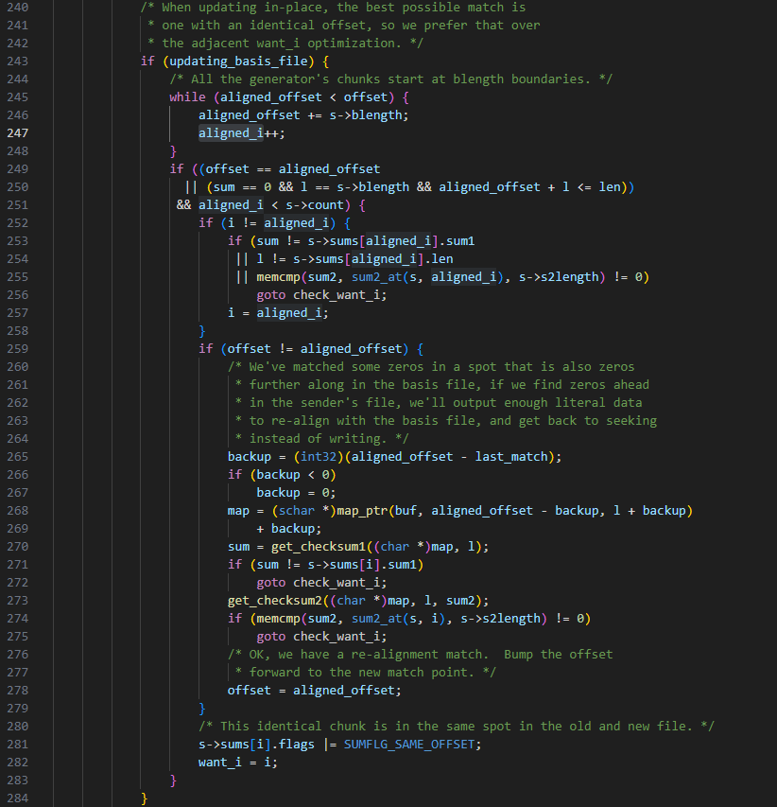
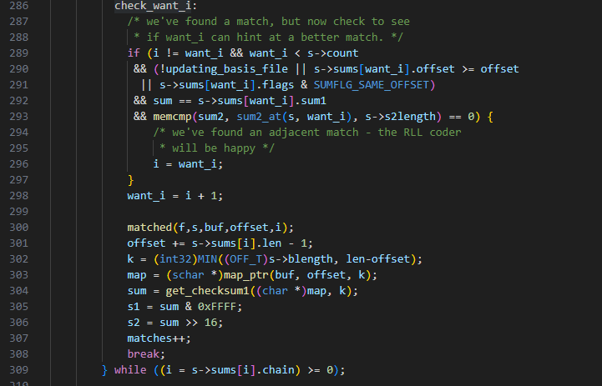
Multiple hits in hash table

Slide 14
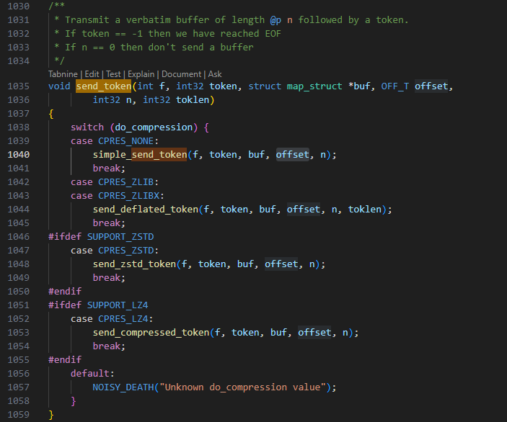
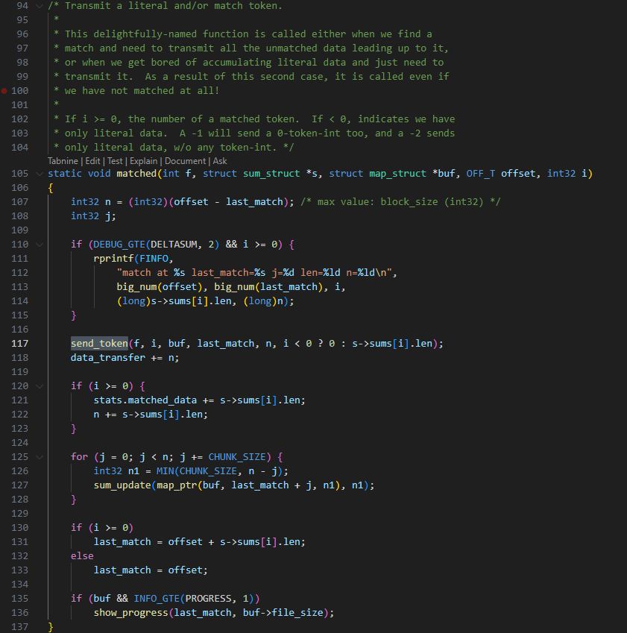
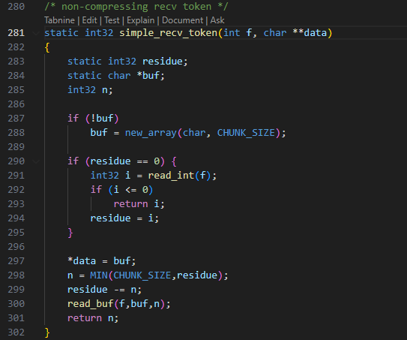
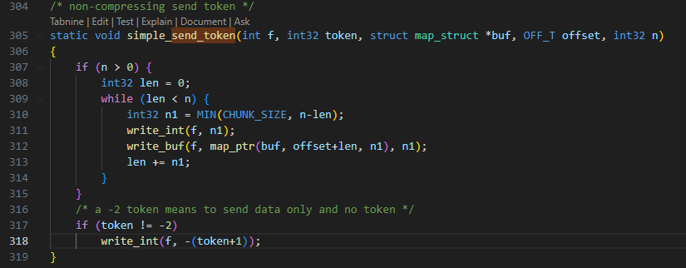
In recv_data():
while ((i = recv_token(f_in, &data)) != 0){…}

Slide 15
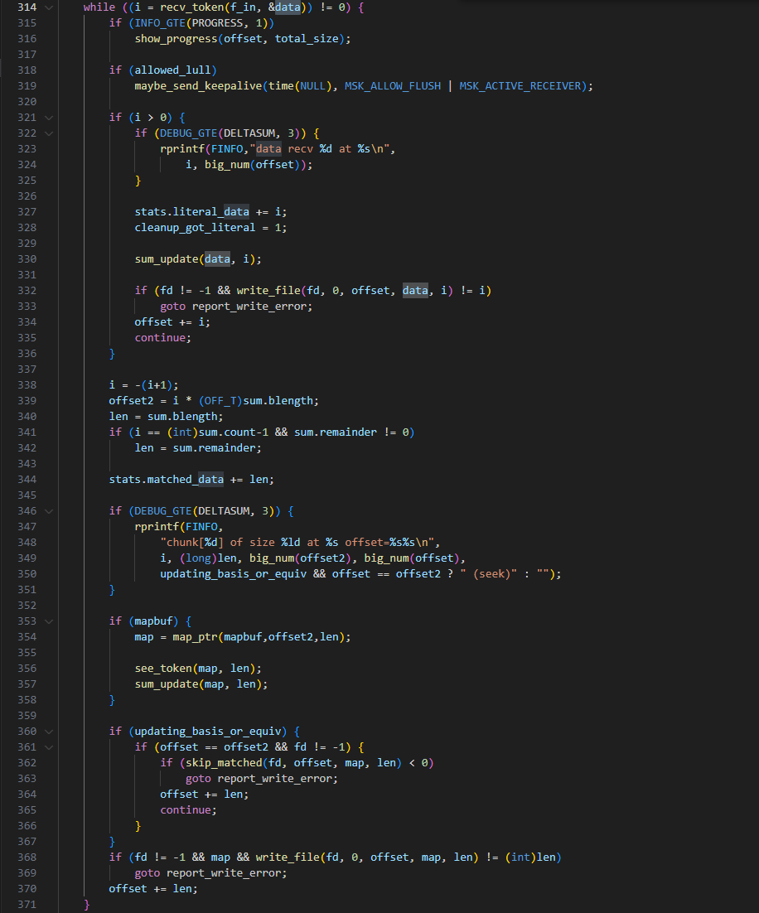

Slide 16
核心问题
delta (encoding)change algorithm
rolling checksum algorithm
The rsync algorithm
1. quick check (size, always checksum, mtime)
2. rolling checksum in send_files()
3. 3-level search in send_files()
Server, Client and Daemon → sender & receiver & generator
send_files()/recv_files()/generate_files()

Slide 17

谢 谢！
THANKS

